Slide 1
Darknet Yolo Demo
報告者：曾秋旺 .
報告日期：2017/10/17.

Slide 2
Outline
Method
Result
video2npy
Predict
npy2video
Demo

Slide 3
Method

Slide 4
Method
Ubuntu中，Python 3.5的 OpenCV無法讀取影片檔 (無法調用解碼器?)
採取分段作業

Slide 5



Video to npy
Windows
.npy檔

Slide 6

Predict
Ubuntu
.npy檔
.npy檔

Slide 7
npy to video
Windows
.npy檔

Slide 8
Result

Slide 9
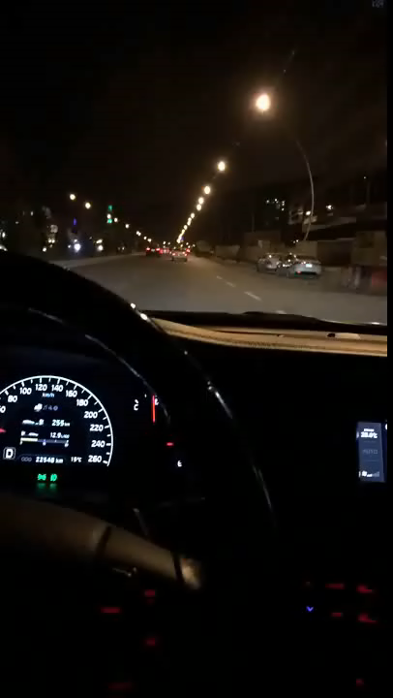
Demo

Slide 10
Thanks for your attention

